Slide 1
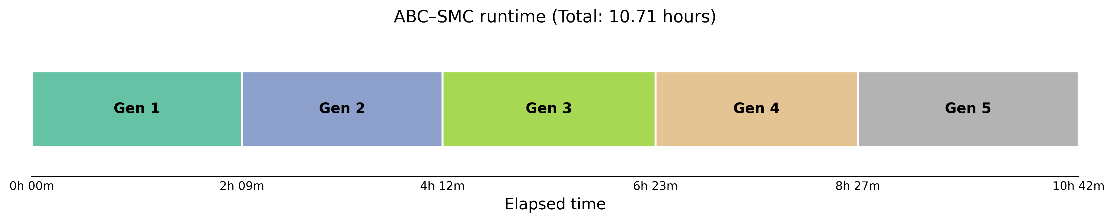
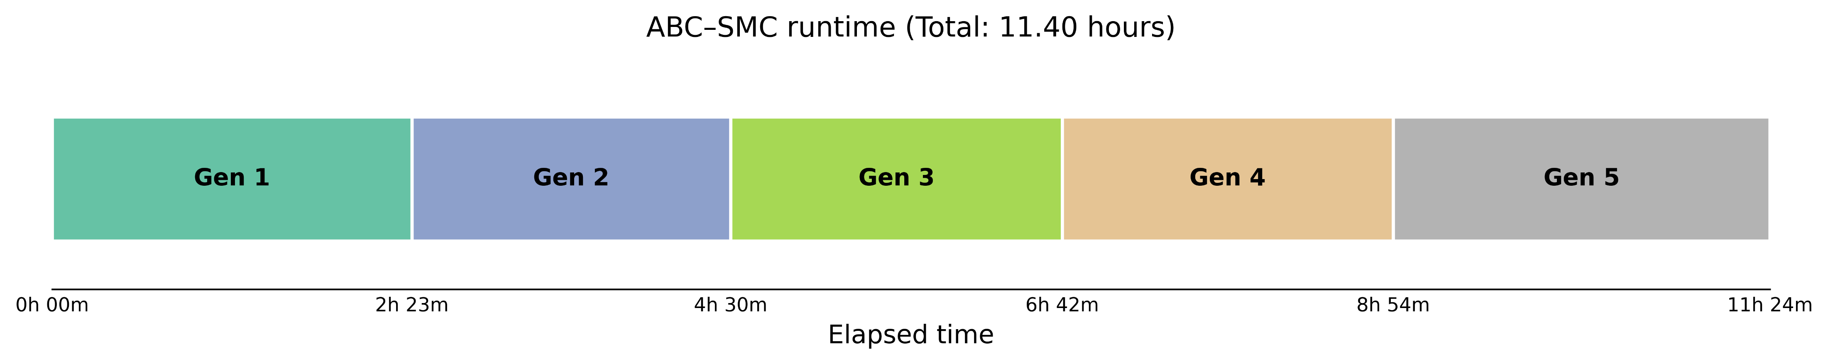
Random seeds
Without random seeds
With random seeds
There was a slight increase in execution time.

Slide 2
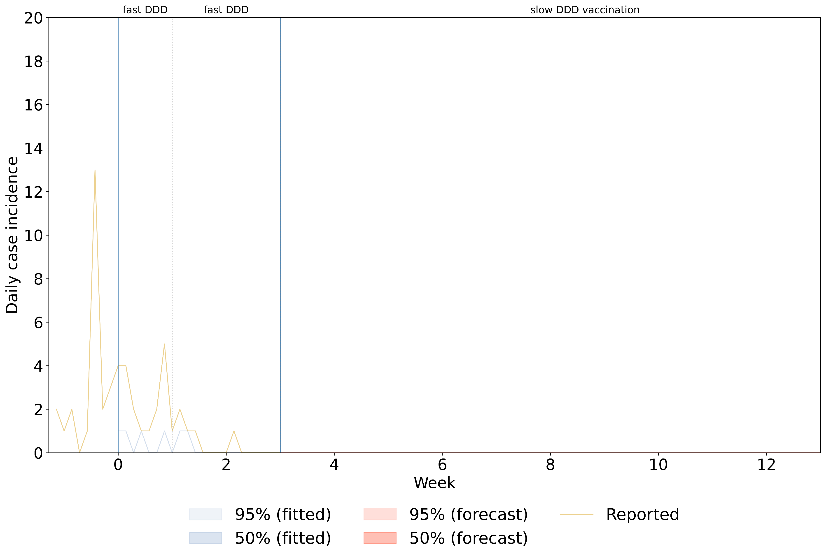
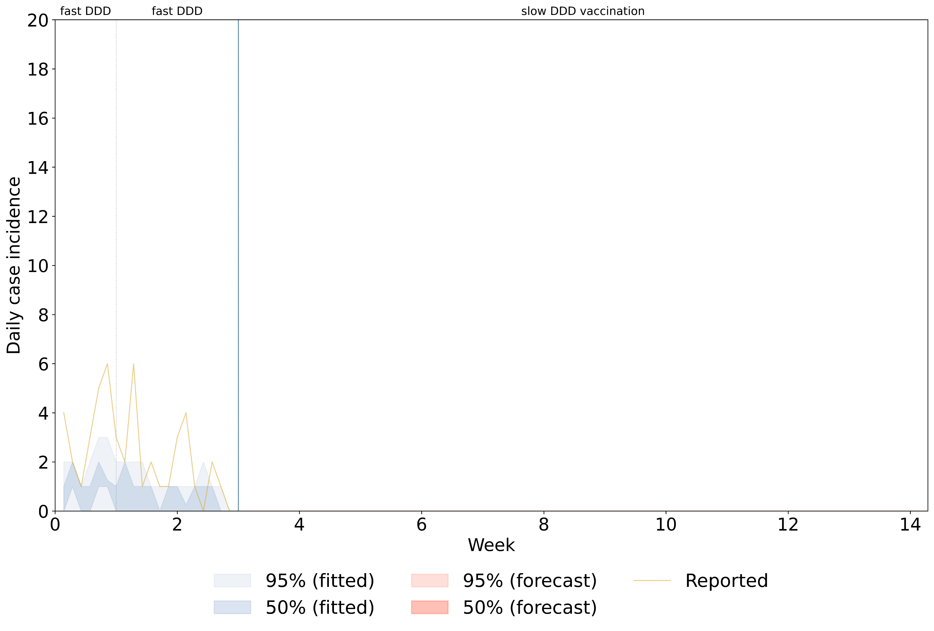
Without random seeds
With random seeds
I have modified the fitting window (previous: t_detect ~ t_detect+21, current: t_start ~ t_start+21).
The outbreak curve (golden line) is based on the exposure dates. Since these dates are estimated retrospectively, the epidemic curve may change depending on a random number from the distribution of periods.
After setting a random seed, credible intervals became visible.

Slide 3
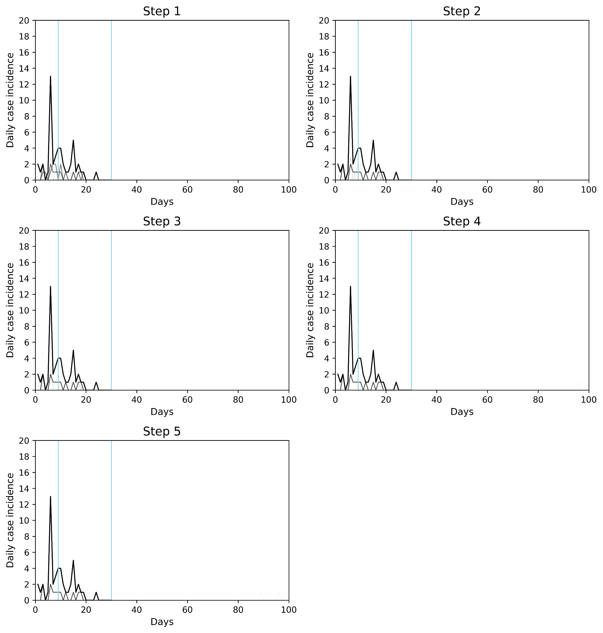
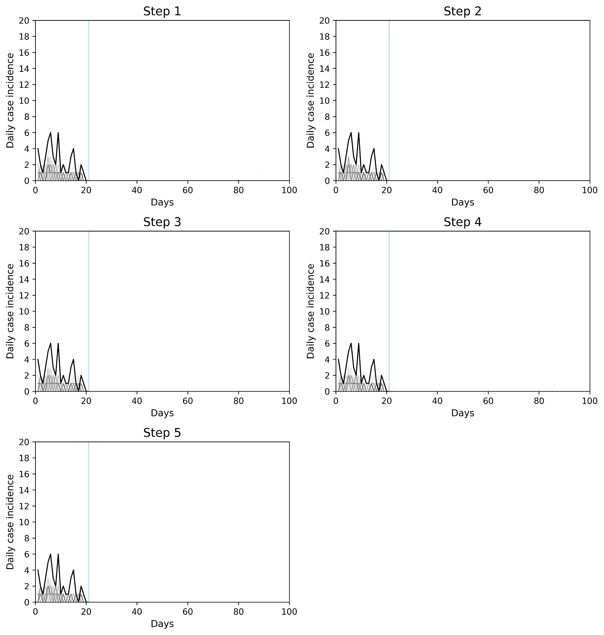
Without random seeds
With random seeds
Fitting window
Fitting window
However, there was no noticeable difference between generations.
Normally, we would expect to see some convergence as the generations progress, but that doesn't seem to be happening here.

Slide 4
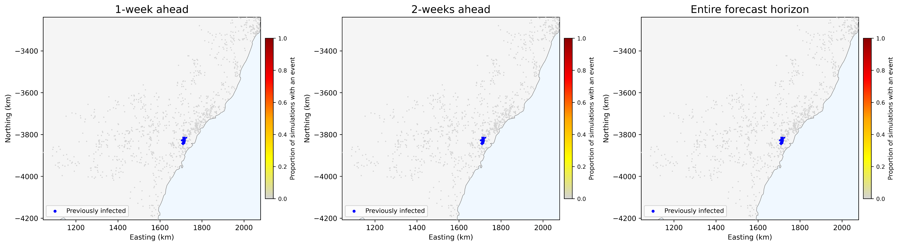

Without random seeds
With random seeds
Since no cases were predicted after t_today, there was no difference in the outbreak map.

Slide 5
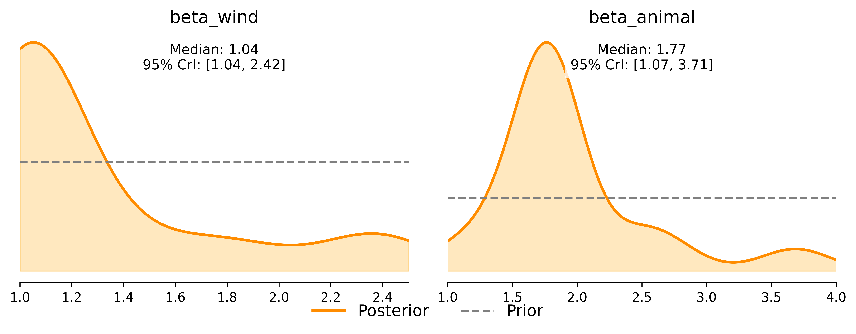
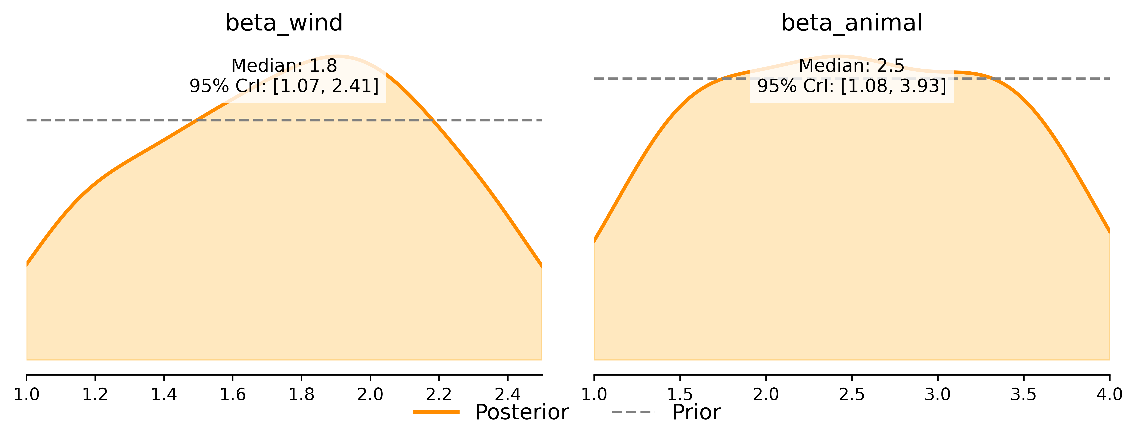
Without random seeds
With random seeds
The true parameter values are 1.5 for beta_animal and 2.5 for beta_wind, respectively.
Surprisingly, when I used a random seed, the parameters didn't seem to be learning much from the data. However, the posterior medians moved closer to the true values.
I suspect the wider posterior distributions might be due to greater diversity in the parameter values explored with the random seed, combined with the small number of accepted particles (60).

